Slide 1
Florence County School District Three
FIRST READING
General Fund Budget
Fiscal Year 2019-2020
Laura Hickson, Ed.S.
Superintendent
Michelle B. Humphrey
Director of Finance
March 21, 2019

Slide 2
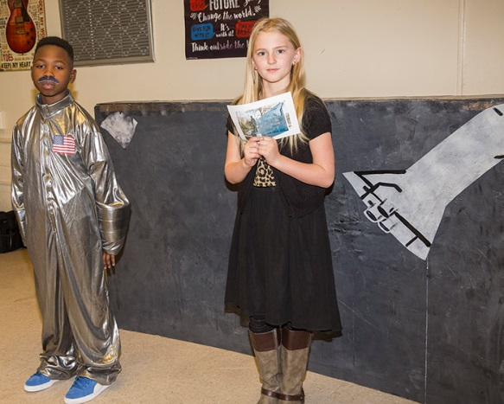
MISSION
Ensuring Our Students are College and/or Career Ready

Slide 3
2019-2020 DISTRICT GOALS
To improve the academic success of all students.
To ensure the safety of all district schools, offices, students, and staff.
To increase the number of students reading on grade level in grades K-3.
To recruit, retain, and train excellent instructional and administrative staff.
To build effective school, community and business relationships/partnerships.
To ensure financial stability.
3

Slide 4
History of Base Student Cost
School Year | Fully Funded | Actual | State Funded FSD # 3 | EFA Shortfall Per pupil
2010-2011 | $2,720 | $1,630 |  | ($1,090)
2011-2012 | $2,790 | $1,876 |  | ($914)
2012-2013 | $2,790 | $1,880 |  | ($910)
2013-2014 | $2,771 | $2,012 |  | ($759)
2014-2015 | $2,742 | $2,101 | $1,813.17 | ($641)
2015-2016 | $2,801 | $2,197 | $1,888.44 | ($604)
2016-2017 | $2,933 | $2,350 | $2,010.29 | ($583)
2017-2018 | $2,984 | $2,425 | $2,062.56 | ($559)
2018-2019 | $3,018 | $2,485 | $2,113.97 | ($533)
2018-2019 | $3,018 | $2,485 | $2,100.59 | **$5 Cap
2019-2020 | IMPLIED | $2,467 | ** State Aid

Slide 5
Education Budget Changes
MOST NOTABLE CHANGES: RESTRUCTURING OF BUDGET LINE
TWO LINES : EFA BASE STUDENT COST + EFA FRINGE =
“ STATE AID TO CLASSROOMS”
D16 1.3 State Aid to Classrooms (formerly EFA Formula/Base Student Cost Inflation Factor): Deletes the requirement to “include an inflation factor projected by the Revenue and Fiscal Affairs Office to match inflation wages of public-school employees in the Southeast,” and deletes any reference to a base student cost. Inserts language to specify that State Aid to Classrooms be allocated as follows: “65.78% must be allocated based on the EFA formula and the differentiated student weightings; 28.47% be allocated based on the manner of distribution of EFA employer contributions in the prior fiscal year; 5.75% be allocated to fully implement the State Minimum Teacher Salary Schedule with a minimum starting teacher salary of $35,000.” Specifies that the “average per pupil State Aid to Classrooms is $3,846.” It inserts a new statewide minimum teacher salary with funds specified for teacher salaries to be distributed to school districts using the EIA Teacher Salary Supplement methodology. Amendment D16 Whitmire.pdf

Slide 6
135 AVERAGE DAILY MEMBERSHIP TREND
SCHOOL YR ADM TREND
2010-2011 3,391.19
2011-2012 3,477.44 +86.25
2012-2013 3,570.04 +92.60
2013-2014 3,558.52 -11.52
2014-2015 3,601.45 +42.93
2015-2016 3,560.55 -40.90
2016-2017 3,522.93 -37.62
2017-2018 3,362.92 -160.03
2018-2019 3,275.98 -86.94 (45 ADM)
2018-2019 3,270.41 -5.57 (90 ADM )
6

Slide 7
BASIS OF BUDGET FY 2020 GENERAL FUND BUDGET ( WAYS AND MEANS )
IMPLIED Base Student Cost : $2,467 House Ways and Means Committee. ($-18/ pupil from FY 19 $2485)
Teacher Pay: 4 % Increase to Scales // Base $35,000
Step Increase: Teachers ( 152 days) Classified (80% contract days) **salaries only- not on stipend scales**
State Aid to Classrooms: $639,614.24 ( allocation for teacher pay increase)
Health Insurance –increase / unknown
State Retirement – estimated increase for employer ( 1%) Current Employer Rate = 14.56 % + 6.05% = 20.61 % FY 19-20 Rate with increase= 15.56% + XX= 22.16% { XX= 6.60 (6.05+.55) using same surcharge increase as 18-19 of .55}

Slide 8
LOCAL TAX
MILLAGE FOR 18-19 206.00
VALUE OF 1 MILL $34,300.16
95% COLLECTION $32,585.15
MILLAGE FOR 19-20 211.03
PROJECTED LOCAL
TAX REVENUE $6,876,327.12
INCREASE FROM 18-19 $161,953.19
Millage increase 5.03 mills

Slide 9
EFA PROJECTIONS
IMPLIED BASE STUDENT COST $2,467
PERCENT OF STATE SUPPORT 85.05%
STATE BASE STUDENT COST $2,098.41
LOCAL BASE STUDENT COST $368.59
PROJECTED 19-20 EFA $10,076,348.11
** Total weighted students based on 45 ADM

Slide 10
PRELIMINARY GENERAL FUND BUDGET FY 2019-2020
REVENUE:
 | LOCAL |  | $ 7,277,327.12
 | STATE |  | $ 20,941,691.26
 | TRANSFER |  | $ 1,276,026.74
 | TOTAL REVENUES |  | $ 29,495,045.12
EXPENDITURES: |  |  |  |  | INSTRUCTIONAL | SUPPORT
 | EMPLOYEE SALARIES |  | $ 16,552,470.29 |  | $ 10,077,475.97 | $ 6,474,994.32
 | EMPLOYEE FRINGE |  | $ 7,756,285.64 |  | $ 4,404,529.43 | $ 3,351,756.21
 | PURCHASED SERVICES |  | $ 3,477,515.42 |  | $ 1,363,474.68 | $ 2,114,040.74
 | SUPPLIES AND MATERIALS |  | $ 1,950,957.60 |  | $ 244,822.65 | $ 1,706,134.95
 | EQUIPMENT |  | $ 47,585.06 |  |  | $ 47,585.06
 | OTHER OBJECTS |  | $ 255,767.13 |  | $ 11,207.56 | $ 244,559.57
 | TRANSFERS |  | $ 59,435.81 |  | $ 54,465.81 | $ 4,970.00
 | TOTAL EXPENDITURES |  | $ 30,100,016.95 |  | $ 16,155,976.10 | $ 13,944,040.85
 | Excess Expenditures over Revenues |  | $ (604,971.83)

Slide 11
TIMELINE FOR 2019-2020 BUDGET APPROVAL
Thursday, March 21, 2019 1st Reading of 2019-2020 Proposed Budget
Tuesday, April 16, 2019 1st Public Hearing @ 6:00 pm
Thursday, May 16, 2019 2nd Public Hearing @ 5:00 pm
Thursday, May 16, 2019 2nd Reading of 2019-2020 Budget
@ May Board Meeting
Thursday, June 20, 2019 FINAL Reading of 2019-2020 Budget
@ June Board Meeting

